Slide 1
HKN ECE 220 Midterm 1
Review Session
Eisa Kamran, David Thomas, Xavier Routh

Slide 2
Logistics
This session is recorded.
Slides & recording will be available on the HKN website.
Exam info: (from course website)
closed-book, closed-note
Thursday 2/27 7:00-8:20
Lectures 1-6
Not much material to cover, we will available after to answer questions / go over worksheets and past exams.
HKN will be holding bonus office hours before your exam Wednesday night from 6:00 and Thursday time tbd in the RSO room
Please fill out the feedback form at the end of this session, it helps us know how to improve for next time!

Slide 3
Topics
LC3 Architecture
LC3 Programming
Pseudo-Ops (Assembler Directives)
Memory-Mapped I/O
TRAPs and Subroutines
Callee vs Caller saved registers
Stacks
Basic C Programming

Slide 4
LC3 Review
Notes:
Review

Slide 5
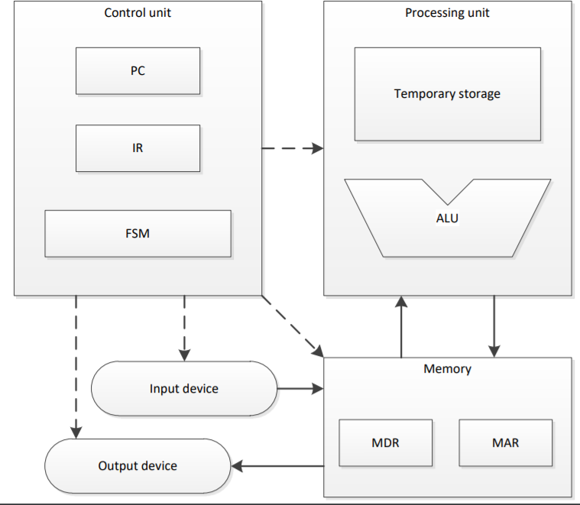
LC3 Architecture
16 bit data and 16 bit address (coincidental).
8 general purpose registers R0-R7
Important registers:
PC (program counter)
IR (instruction register)
Memory control
MAR (address)
MDR (data)
Memory-Mapped I/O (Discussed in detail later)

Slide 6
LC3 Assembly
Numbers are 16 bit 2’s complement
Memory Addressing Modes
Indirect
PC-Relative
Base + Offset
Logic Ops
ADD, AND, NOT
Memory Ops
LD, LDI, LDR, ST, STI, STR, LEA
Control Ops
BR(nzp), JSR/JSRR, JMP/RET, RTI

Slide 7
Pseudo-Ops (Assembler Directives)
.ORIG x3000 | tells the loader where to place the program into memory
.END | marks the end of the LC3 program (not HALT)
.FILL | used to place values in memory
.BLKW | used to reserve space in memory for a value (used for labels)
.STRINGZ | allocates space for and places a string w/ a null terminator

Slide 8
Common LC3 Operations
How to clear R0?
AND R0, R0, #0
How to copy R1 to R0?
ADD R0, R1, #0
How to negate a value; how to get -1 * R0?
NOT R0, R0
ADD R0, R0, #1
How to left-shift R0?
ADD R0, R0, R0
How to add #30 to R0
ADD R0, R0, #30 (note: -16 <= imm <= 15)
ADD R0, R0, #15
ADD R0, R0, #15

Slide 9
LC3 Warmup
What are the values in R4, R3, R2, at the end of this program?
.ORIG x3000
LD R4, MYLABEL ;
LDI R3, MYLABEL ;
LDR R2, R4, #1 ;
HALT ;
MYLABEL .FILL x5001 ;
.END
Address: | Data:
x5001 | x7001
x5002 | xE15A
… | …
x7001 | x8001
x7002 | x8002

Slide 10
Issues with LC3
Code is often repeated,
Solutions?
Subroutines, Traps.
LC3 Code is difficult to write
Have to manually track registers
Have to write multiple instructions to do a simple thing
Solutions?
Higher level language: C

Slide 11
Input / Output

Slide 12
Memory Mapped I/O
How does the programmer interact with I/O devices?
Memory instructions! ST, LD, etc…
Memory-Mapped I/O
Represent keyboard / monitor ‘registers’ as memory addresses.
‘Registers’ are logically treated as part of LC3’s main memory.
But, ‘Registers’ are physically separate from main memory.
Requires extra memory address hardware to deal with device addresses.

Slide 13
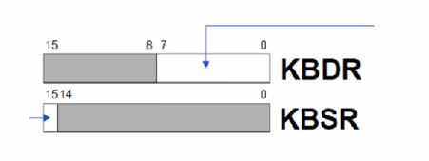
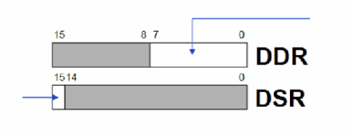
I/O Device Registers
Keyboard Registers
KBDR (data): stores ASCII value entered from keyboard
Ready bit [15] indicates if a new character has been typed on the keyboard.
KBSR (status): let processor know a new value is entered
Display Registers
DDR (data): store ASCII value to be displayed on monitor
DSR (status): let processor know a new value is ready to be displayed
Notes:
TODO: Might want a slide on ASCII

Slide 14
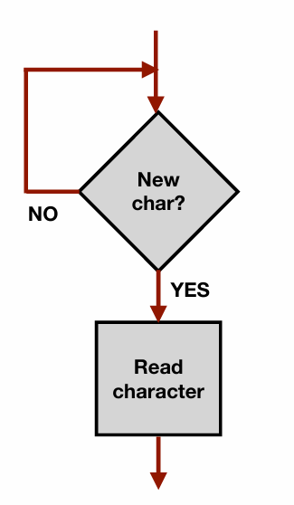
Polling Keyboard Input
POLL LDI R1, KBSR ;
BRzp POLL ;
LDI R0, KBDR ;
(rest of program);
KBSR .FILL xFE00;
KBDR .FILL xFE02;
Don’t we have to unset the ready bit? (KBSR[15])
No, keyboard hardware unsets it once KBDR is read.

Slide 15
I/O Polling Routine
Keyboard Registers
KBDR: stores ASCII value entered from keyboard
KBSR: let processor know a new value is entered
Monitor / Display Registers
DDR: store ASCII value to be displayed on monitor
DSR: let processor know a new value is ready to be displayed
Notes:
TODO: Might want a slide on ASCII

Slide 16
I/O Polling vs Interrupts
Polling:
Loop indefinitely until data is available by checking status registers (KBSR, DSR).
Used in 220.
What are downsides?
Interrupts:
Allows program to perform other work while no data is available.
Upon reception of interrupt, pause current code execution and execute special interrupt handling functions.
Return to interrupted code once interrupt has been handled.
Will be covered in depth later in ECE 220 and in ECE 391!

Slide 17
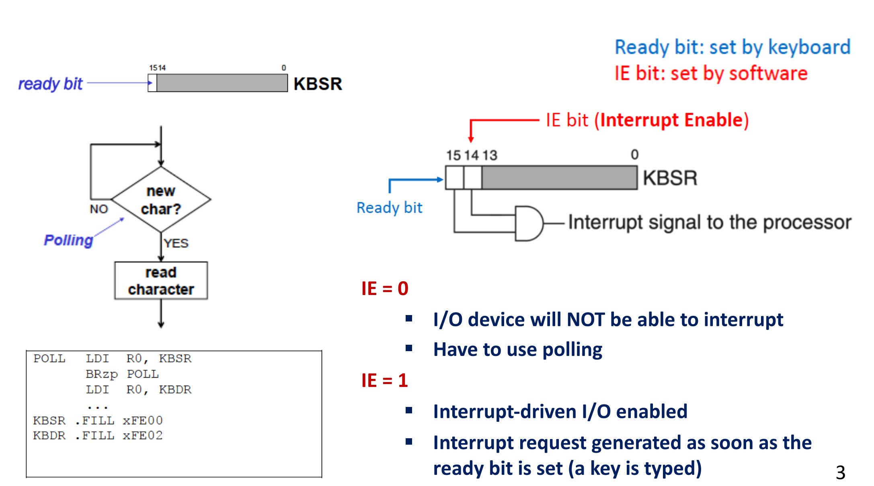
LC3 - I/O (Diagram)

Slide 18
LC-3 Review: I/O
Memory Mapped I/O
Map I/O to specific memory addresses
Removes the need for dedicated I/O channels
Accessing the mapped memory address gives access to the input or output device
Reading from xFE02 (KBDR) returns a char of what key was pressed on the keyboard
Writing ‘a’ to xFE06 (DDR) will display ‘a’ on the display
Check the status register (KBSR, DSR) of the respective input/output before reading or writing

Slide 19
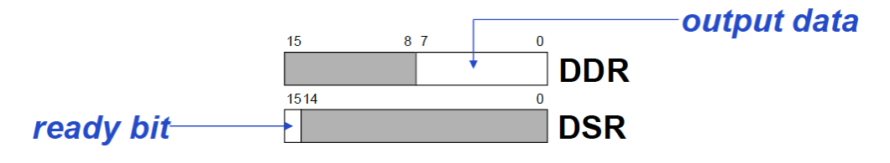
LC-3 Review: Polling Display Output
Writing to the display
Poll DSR until ready bit is set then write display data to DDR
POLL | LDI BRzp STI | R1, DSR POLL R0, DDR | ; Check status register ; Loop while ready bit not set ; Write display data
DSR | .FILL | xFE04 | ; DSR address
DDR | .FILL | xFE06 | ; DDR address

Slide 20
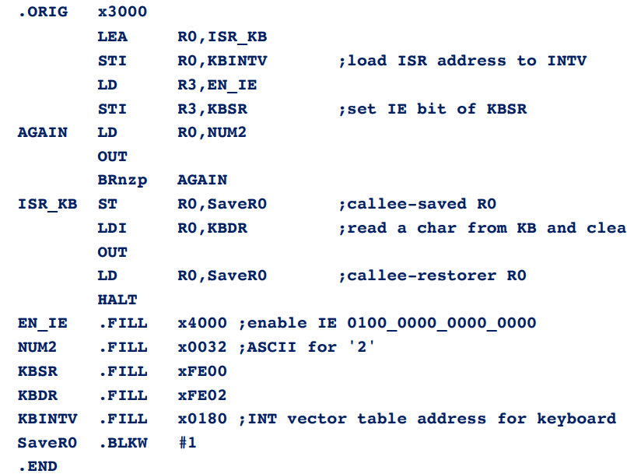
Interrupt I/O
Interrupt I/O stops the flow of the program to input data
Allows to change the flow of the program
Featured more in future classes down the line

Slide 21
TRAPs and Subroutines

Slide 22
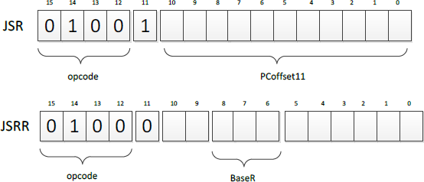
Subroutines
Useful if there is a code segment that needs to be executed multiple times
Subroutines can be invoked by JSR or JSRR
Return is implemented with RET instruction
What does JSR do differently than the BR instruction?
TEMP <- PC
If (IR[11] == 0)
PC <- BaseR
Else
PC <- PC + SEXT(PCoffset11)
R7 <- TEMP
Notes:
JSR has a longer 11 bit offset range than the BR 9 bit offset. JSR saves R7

Slide 23
Subroutines: Callee and Caller Save
Subroutine will save and restore registers that it modifies except for the return values
The only visible change should be the return value (if any) upon return
Caller should save registers that could be modified by the subroutine or if they contain important data
Eg.: R7 would need to be saved since JSR and JSRR overwrite its value
; Caller-save user program
…
ST R0, SaveR0
ST R7, SaveR7
JSR MY_SUBROUTINE
LD R7, SaveR7
…
LD R0, SaveR0
…
HALT
SaveR0 .BLKW #1
SaveR7 .BLKW #1

Slide 24
Subroutines: Conceptual Questions
What are some benefits of using Subroutines?
What can happen if you do not callee save your registers?
What cases do problems occur?
What will happen if you forget to callee save R7 if it has been modified in the subroutine?

Slide 25
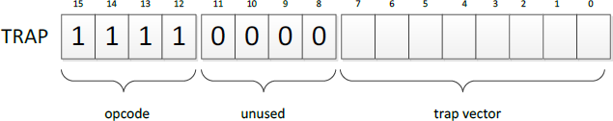
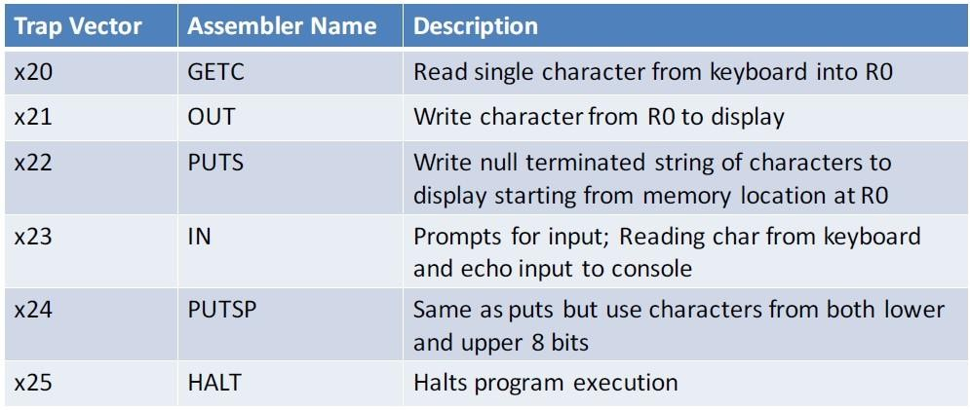
TRAPs
TRAP function
Same as subroutines, but for “system” code / functionality
Programmers can use complex operations without specialized knowledge
Only the person who writes TRAPs needs to know about KBDR, KBSR, etc…

Slide 26
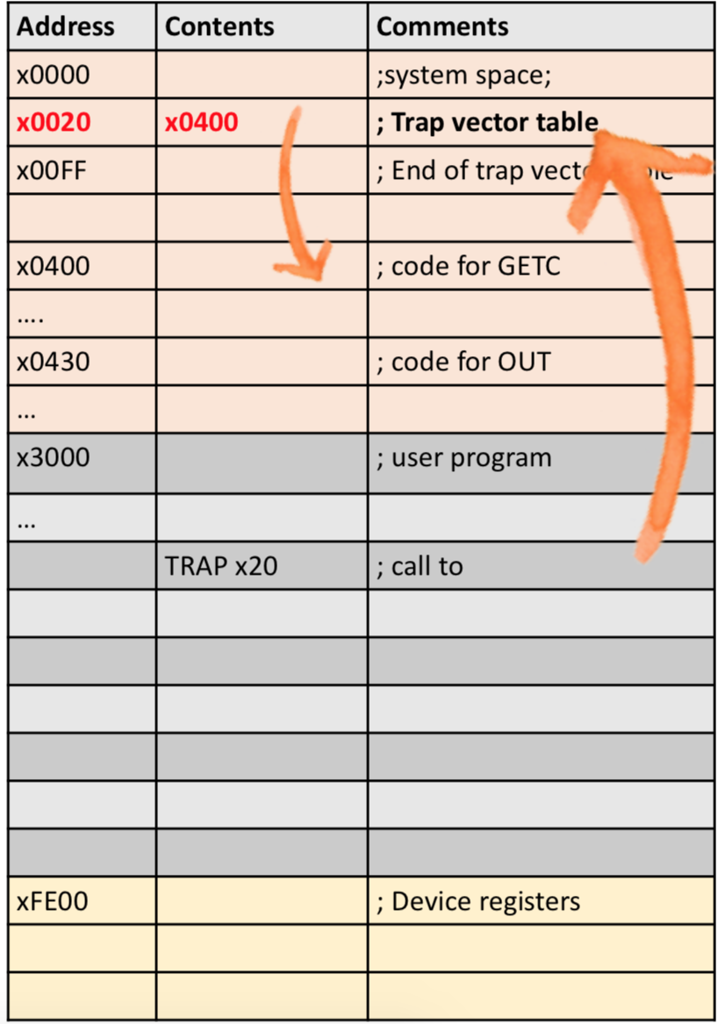
TRAPs: How they work
TRAP function is called by the user
The 8-bit trap vector is used as the index of the service routine’s address in the trap vector table
The PC is loaded with the address of the service routine
After executing the service routine, control returns to the user program

Slide 27
TRAPs: Conceptual Questions
How are TRAP service routines different from user written subroutines?
Where does the TRAP instruction take the code?

Slide 28
Problem with nested calls
SWAP
ST R2, SAVER2_SWAP ST R3, SAVER3_SWAP
LDR R2, R0, #0 LDR R3, R1, #0 STR R2, R1, #0 STR R3, R0, #0
LD R2, SAVER2_SWAP
LD R3, SAVER3_SWAP
RET
REVERSE
ST R0, SAVER0_REVERSE
ST R1, SAVER1_REVERSE
ST R2, SAVER2_REVERSE
ST R3,SAVER3_REVERSE RLOOP
JSR SWAP
ADD R0, R0, #1 ADD R1, R1, #-1 NOT R2, R0 ADD R2, R2, #1 ADD R3, R2, R1 BRp RLOOP
LD R0, SAVER0_REVERSE LD R1, SAVER1_REVERSE LD R2, SAVER2_REVERSE LD R3, SAVER3_REVERSE RET
LD R0, START
LD R1, END
JSR REVERSE HALT
Notes:
In LC3, JSR (Jump to Subroutine) stores the return address in R7. Each time JSR is called, the current return address is overwritten.
When REVERSE calls SWAP using JSR SWAP, it overwrites R7, which contains the return address of REVERSE. Once SWAP finishes, the return address for REVERSE is lost, so returning from REVERSE leads to an incorrect location, causing the program to malfunction.
You need to save R7 before calling another subroutine inside REVERSE and restore it after the call. For example, add this in REVERSE before calling JSR SWAP: And after returning from SWAP, restore it

Slide 29
Stacks

Slide 30
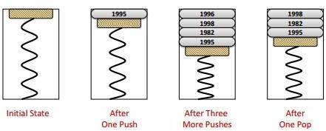
Stacks
Last-In-First-Out (LIFO, same as FILO)
Stack operations:
Push: Adds a new item to the top of the stack.
Pop: Removes the item on the top of the stack.
IsEmpty: Checks if the stack is empty.
IsFull: Checks if the stack is full.

Slide 31
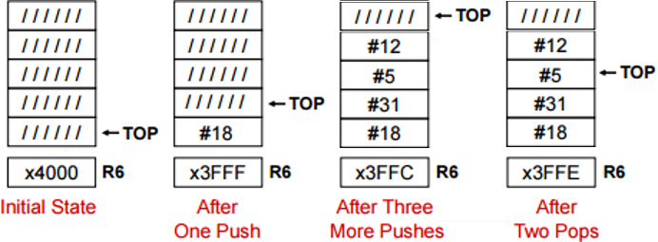
Stacks: Continued
Implementation
Keep elements stationary, just move the pointer for TOP
More efficient than moving everything
NOTICE: Different conventions for TOP: can indicate next empty slot or last pushed element in the stack
END always points to the last fillable slot on the stack

Slide 32
Stacks: Conceptual Questions
Explain the dangers of overflow and underflow.
Where are the numerically higher memory addresses on the stack?
What are the security risks with stacks?
How would you check the remaining size of your stack?
Notes:
Overflow: can overwrite other memory not allocated to the stack. Underflow: can read memory from the TOP pointer that was not pushed into the stack.
Higher memory is lower than the others.
Popping off of the stack does not delete the memory, only moves the pointer. So it can be read later

Slide 33
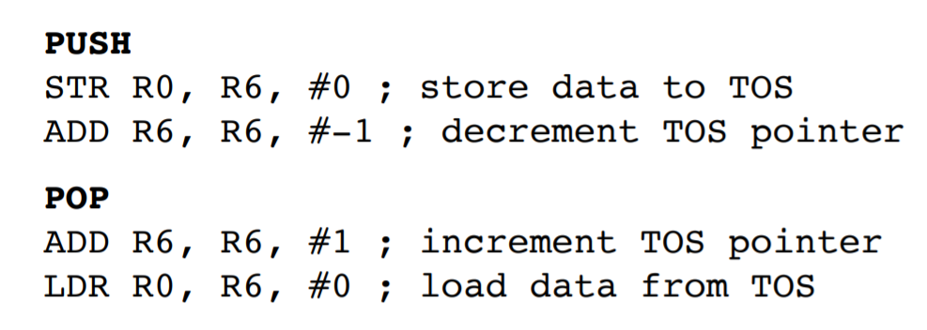
Stacks: Push and Pop

Slide 34
ST R3, PUSH_SAVER3
ST R4, PUSH_SAVER4
AND R5, R5, #0 //Clear R5
//Calculating Overflow:
//TOP = END
LD R3, STACK_END
LD R4, STACK_TOP
ADD R3, R3, #-1
NOT R3 //2’s complement of R3
ADD R3, R3, #1
ADD R3, R4, R3
BRz OVERFLOW
STR R0, R4, #0 //Push value in R0 to stack
ADD R4, R4, #-1 //Update stack top
ST R4, STACK_TOP
BRnzp DONE_PUSH
OVERFLOW
ADD R5, R5, #1
//Return 1 in R5 if overflow
DONE_PUSH
LD R3, PUSH_SAVER3
LD R4, PUSH_SAVER4
RET
//Restore R3 and R4
//Make sure not to modify R7
Push

Slide 35
ST R3, POP_SAVER3
ST R4, POP_SAVER4
AND R5, R5, #0 //Clear R5
//Calculating Underflow:
//TOP = START
LD R3, STACK_START
LD R4, STACK_TOP
ADD R3, R3, #-1
NOT R3 //2’s complement of R3
ADD R3, R3, #1
ADD R3, R4, R3
BRz UNDERFLOW
LDR R0, R4, #0 // Load value pushed in R0
ADD R4, R4, #1 //Update top of stack
ST R4, STACK_TOP
BRnzp DONE_POP
UNDERFLOW
ADD R5, R5, #1
//Return 1 in R5 if underflow
DONE_POP
LD R3, POP_SAVER3
LD R4, POP_SAVER4
RET
//Restore R3 and R4
//Make sure not to modify R7
Pop

Slide 36
Practice Questions
Assume 3 items have been pushed onto the stack. After a POP operation, will the last item pushed onto the stack be erased from memory? Explain.
Notes:
No, remember only the pointer is moved

Slide 37
Stacks: Conceptual Questions
Explain the dangers of overflow and underflow.
Where are the numerically higher memory addresses on the stack?
What are the security risks with stacks?
How would you check the remaining size of your stack?
Notes:
Overflow: can overwrite other memory not allocated to the stack. Underflow: can read memory from the TOP pointer that was not pushed into the stack.
Higher memory is lower than the others.
Popping off of the stack does not delete the memory, only moves the pointer. So it can be read later

Slide 38
Practice Stacks Question
The input stream of a stack is a list of all the elements we pushed onto the stack, in the order that we pushed them. If the input stream is
ZYXWVUTSR,
create a sequence of pushes and pops such that the output stream is YXVUWZSRT.
Notes:
PUSH PUSH
POP(Y)
PUSH
POP(X)
PUSH PUSH
POP(V)
PUSH
POP(U) POP(W) POP(Z)
PUSH PUSH
POP(S)
PUSH
POP(R) POP(T)

Slide 39
If the input stream is ZYXWVUTSR, create a sequence of pushes and pops such that the output stream is YXVUWZSRT. A “PUSH” reads in one character from the input stream and a “POP” writes a character to the output stream.
PUSH PUSH
POP(Y)
PUSH
POP(X)
PUSH PUSH
POP(V)
PUSH
POP(U) POP(W) POP(Z)
PUSH PUSH
POP(S)
PUSH
POP(R) POP(T)
Notes:
PUSH PUSH
POP(Y)
PUSH
POP(X)
PUSH PUSH
POP(V)
PUSH
POP(U) POP(W) POP(Z)
PUSH PUSH
POP(S)
PUSH
POP(R) POP(T)

Slide 40
C Programming

Slide 41
C
C is a high level language
Abstraction from hardware details
C is a imperative language
specifies an explicit sequence of steps to follow
Compilation vs Interpretation
Compilation: translates statements into machine language (c, c++)
Interpretation: executes program statements (python, matlab)

Slide 42
C Examples
https://onlinegdb.com/nh2d5IUU_

Slide 43
Basic C Program Structure
#include <stdio.h>
#define PI 3.141576f
int main(){
float r; /* radius */
float A; /* area */
printf("Enter radius: ");
scanf("%f", &r);
A = PI * r * r; /* area */
printf("A=%f \n", A);
return 0;
}

Slide 44
Data types/formats
%d: decimal integer
int, long, long long, unsigned
%f: floating-point number
float, double
%c: ASCII character
char
%s: string

Slide 45
Declaring Variables
Any combination of letters, numbers, and underscore(_)
Case matters
Cannot begin with a number
int num;
char c = ‘c’;

Slide 46
Scope
The region of the program in which the variable is “alive”
Local variables
Accessible within a block
Block defined by open and close braces { }
Global variables
Accessible throughout the program
Storage class :
Automatic
– Lose value once block is completed (local variables are automatic by default)
Static
– Retain value throughout program

Slide 47
Operators
Assignment:
=
Arithmetic:
*, +, -, /, %
Bitwise
~, <<, >>, &, ^, |
Comparison
>, >=, <, <= , ==, !=
Logical
!, &&, ||
Increment/Decrement
++, - -

Slide 48
Arrays
data_type array_name[size];
int arr[3] = {1, 2, 3}; //example
A string is an array of chars, terminated by NULL character
Array is fixed size - cannot be extended past initial declared size
Can passed only by reference into functions

Slide 49
C Programming: i++ vs ++i
I+
x = 4;
y = x++;
//result: x=5 y=4
x = 4;
y = ++x;
//result: x=5 y=5

Slide 50
Control Structure
Conditional:
Making a decision about which code to execute, based on evaluated expression
if
if-else
switch
Iteration
Executing code multiple times, ending based on evaluated expression
while
for
do-while

Slide 51
if & if-else
if (condition){
action;
}
if (condition){
action_if;
}
else{
action_else;
}

Slide 52
switch
switch (expression) {
case const1:
action1;
break; //break statement is required
case const2:
action2;
break;
default:
action3; //default action is optional
}

Slide 53
while vs do-while
while (test){
loop_body;
}
do{
loop_body;
}while (test);

Slide 54
for
for (init; end-test; update) {
statement
}
for (int i=0; i < 10; i++) {
statement
}

Slide 55
break vs continue
break
used only in switch or iteration statement
used to exit a loop before terminating condition occurs
continue
used only in iteration statement
end the current iteration and start the next

Slide 56
Practice Problems

Slide 57
Fill in the blanks to perform multiplication and get the result of 5 times 6 (5*6) in Register 1
.ORIG x3000
_LD R0,OP1 ; load R0 with OP1
__LD R2,OP2_ ; load R2 with OP2
__AND R1,R1,#0 ; clear R1
LABEL
__ADD R1,R1,R0____________
__Add R2,R2,#-1 ____________
BRp LABEL
HALT
OP1 .FILL #5
OP2 .FILL #6 .END
Notes:
LD R0 OP1
LD R0 OP1
AND R1 R1 #0
ADD R1 R1 R2
ADD R0 R0 #-1
BRp LABEL

Slide 58
Fill in the blanks to perform multiplication and get the result of 5 times 6 (5*6) in Register 1
.ORIG x3000
______________ ; load R0 with OP1
______________ ; load R2 with OP2
______________ ; clear R1
LABEL
______________ ; Add R1 + R2, Result into R1
______________ ; Decrement our counter
______________ ; If counter is greater than 0, go back to beginning of loop.
HALT
OP1 .FILL #5
OP2 .FILL #6 .END
LD R0, OP1
LD R2, OP2
AND R1, R1, #0
ADD R1 R1 R2
ADD R0 R0 #-1
BRp LABEL
Notes:
LD R0 OP1
LD R0 OP1
AND R1 R1 #0
ADD R1 R1 R2
ADD R0 R0 #-1
BRp LABEL

Slide 59
LC3 Problem Tips
Use LABELS.
BR == BRnzp.
Draw a flowchart of the algorithm.
Make a register table:
Assign different registers to specific functionality when the task is complex (R1 for row count, R2 for column count, etc).
R7 should not be changed. Ever!!!
If you get stuck, don’t get frustrated. Breathe and start over.

Slide 60
HKN Entertainment System

Slide 61
HKN Entertainment System
HKN wants to create a new game console based on the LC3 architecture, however in order to do this we need to add new features.
A joystick! Nobody wants to play games with a keyboard.
What do we need to do to support adding a joystick to the system?
Goal is to make sure you understand LC3, TRAPs, memory-mapped I/O.

Slide 62
HKNES: Joystick Design Decisions
Modify original LC3 Architecture
Add new device registers into memory mapped I/O?
JSSR
JSDR
Would need to manufacture our own LC3 systems, whatever.
or Reuse existing device registers?
Can’t use keyboard and joystick at the same time. Hacky

Slide 63
HKNES: Joystick
What data does the programer need from the joystick?
Direction (X, Y)
Button pressed (too expensive, no button, use keyboard!)
How do we represent direction?
Two 8 bit numbers
Is 8 bits enough?
Signed or unsigned?
How do we send this information to LC3
Two data registers?
JSDRX, JSDRY
Share one data register?
JSDR[15:7] = X, JSDR[7:0] = Y
What addresses do our registers use in memory space (remember this is memory-mapped i/o)

Slide 64
HKNES: Joystick Handshake
How does the program know when to read the joystick data?
Do we need a status register?
Joystick always has data to report, even if it’s just at position (0, 0)
Lets not have a status register, instead we are always ready.

Slide 65
HKNES: Joystick Programming Interface
How does a game developer (someone who wants to write a program that uses the joystick) use the joystick?
We need to write TRAPs for the developers to use!
We also need to add the TRAPs to the trap vector table.
What TRAP vector is available to use?
Notes:
x27 onwards is free I think

Slide 66
HKNES: Joystick TRAP
Do we need to callee save?
READJS
LDI R0, JSDRX ;
LDI R1, JSDRY ;
RTI ;
JSDRX .FILL xFEBO;
JSDRY .FILL xFEB1;
Vector | Symbol | Address
x20 | GETC
…
x28 | READJS | READJS

Slide 67
HKNES: Joystick Drift
Whoever manufactured our joystick did a horrible job. It was found that all joysticks drift 10 units in the X direction.
We can’t afford to remake joysticks and ship them again, can we fix this in a software update instead?

Slide 68
HKNES: Joystick Drift
Whoever manufactured our joystick did a horrible job. It was found that all joysticks drift 10 units in the X direction.
LDI R0, JSDRX ;
ADD R0, R0, #-10;
LDI R1, JSDRY ;
RTI ;
JSDRX .FILL xFEBO;
JSDRY .FILL xFEB1;

Slide 69
HKNES: Microtransactions
HKN is broke, the department doesn’t pay us for review sessions, the HKNES project has made no money, We need to make more money.
Idea -> Add microtransactions to HKNES games
Need to add a credit card reader.

Slide 70
HKNES: Microtransactions
What registers to add:
CCSR
CCDR (stores the whole credit card number?)
How should our TRAP be implemented
Do we need polling?

Slide 71

Good Luck! (^-^)ゝ
Feedback form / Worksheet:
Please fill out feedback form!

